Slide 1


Client Development with .NET 6
Isaac Levin
Notes:
Welcome to .NET Conf – Focus on Windows! We’re very excited to bring you another event that focuses on specific things you can do with .NET. Today, we’re going to talk all about Windows desktop development.

Slide 2
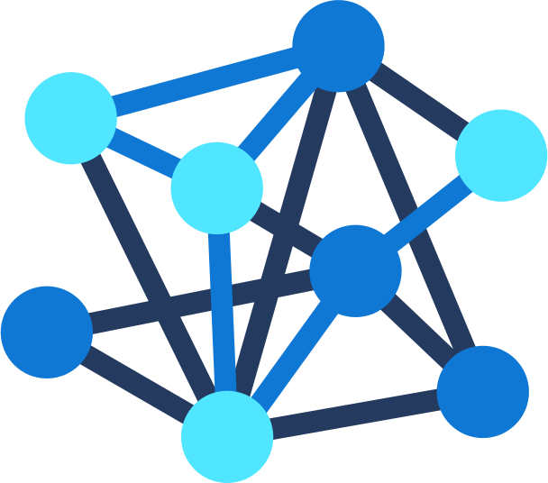




.NET – A unified platform
TOOLS
DESKTOP
WEB
CLOUD
MOBILE
GAMES
IoT
AI
VISUAL STUDIO
VISUAL STUDIO FOR MAC
.NET
LIBRARIES
VISUAL STUDIO CODE
INFRASTRUCTURE
CLI
RUNTIME COMPONENTS
COMPILERS
LANGUAGES
Notes:
We’ve made significant advancements in the platform since it was open sourced in 2014. Together, Microsoft and the community has extended the capabilities of .NET to cover workloads we never had before, like Linux workloads and Machine Learning & AI. And we’ve got a full set of tools with the Visual Studio family all with great support for .NET.
<CLICK>

Slide 3
.NET – A unified platform
TOOLS
WINDOWS DESKTOP
WEB
CLOUD
MOBILE
GAMES
IoT
AI
VISUAL STUDIO
VISUAL STUDIO FOR MAC
.NET
LIBRARIES
VISUAL STUDIO CODE
INFRASTRUCTURE
CLI
RUNTIME COMPONENTS
COMPILERS
LANGUAGES
Notes:
Today we’re going to focus on Windows desktop apps and how to bring them forward to the modern .NET 5 platform.
<CLICK>

Slide 4





Controls for Windows apps on .NET 5
PARTNERS
Notes:
.NET has a rich ecosystem of partners building additional tools and controls to help you build beautiful, full-featured, applications faster. We have many partners releasing support for Winforms, and WPF on .NET 5 in their tools and controls as well. SyncFusion, Progress Telerik, Infragistics, GrapeCity and DevExpress all have great controls for multiple app models for .NET 5. Most of them are also supported in the designer today and more are coming with designer support soon.
THANK YOU!!
<CLICK>
Notes:
Telerik: Full design-time support
GrapeCity: Our .NET 5 controls do support the designer already, and we are working to support .NET Framework controls in the .NET 5 designer. We want customers to move to .NET 5 controls which 100% support the designer.
Infragistics: Yes, we have .NET 5 controls for WPF, Windows Forms, Blazor, and MVC. Design time for WPF (released last year) and Windows Forms (customers have access in release beta, might RTM next month), Tag Helpers across all the MVC / web products. See: https://www.infragistics.com/community/blogs/b/infragistics/posts/announcing-infragistics-ultimate-20-2-what-s-new.
Syncfusion: Yes, we can confirm that we are working on designer support.
DevExpress: Yes, we are working on designer support.

Slide 5
Why .NET 6 for Windows apps?
Enhanced development experience in Visual Studio
Self-contained, single file EXEs
Flexible deployment; side-by-side, ClickOnce
Latest language & API enhancements
Modern controls like WebView2
Third-party tools and controls
.NET
Notes:
We know there are millions of Windows desktop applications out there written many years ago that are still business critical today that are being actively developed. We want to make sure these apps not only run on the latest .NET but can also be developed with the latest version of Visual Studio. That’s why we’ve worked to bring these workloads to .NET Core and now .NET 5.
With .NET 5, we’ve completed this work by bringing the full Visual Studio development experience to you, including third-party control and component vendors you may be using today, and clickonce installer support. By moving forward, these apps can get all the benefits of .NET 5 like self-contained, single file EXEs that don’t need the .NET Framework on the machine. You decide when you want to update, not the Windows OS. You can also use new, modern Windows 10 controls like WebView2, a modern browser control based on Microsoft Edge Chromium.
Now we know it can be time consuming porting your applications from .NET Framework to the latest .NET versions. How can you get here more quickly?
<CLICK>

Slide 6
Windows Forms on .NET 6

Slide 7
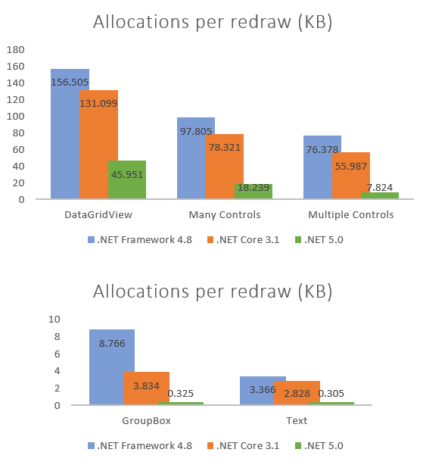
What’s new in Windows Forms?
Performance improvements
Visual Basic support
New and updated controls
ClickOnce Deployment
Modern Browser Control (WebView2)
Accessibility improvements
SDK for third-party control vendors in preview
Notes:
Performance – We refactored the old WinForms code to use GDI instead of GDI+ where possible and benefit from newer APIs. These optimizations resulted significant reduction in memory consumptions in redraw paths, in some cases saving x10 in memory allocations. (blog post: https://devblogs.microsoft.com/dotnet/whats-new-in-windows-forms-runtime-in-net-5-0/#performance-improvements)
Visual Basic (blog post: https://devblogs.microsoft.com/dotnet/visual-basic-winforms-apps-in-net-5-and-visual-studio-16-8/)
New and updated controls - New TaskDialog control and improvements in ListView (blog post: https://devblogs.microsoft.com/dotnet/whats-new-in-windows-forms-runtime-in-net-5-0/#windows-controls-additions-and-enhancements)
Accessibility – updated controls to meet today’s accessibility requirements (blog post: https://devblogs.microsoft.com/dotnet/whats-new-in-windows-forms-runtime-in-net-5-0/#accessibility-improvements-and-fixes)
SDK for third-party control - we are working with the control vendors on our SDK and making great progress together. (16.9 RTM)

Slide 8
WPF on .NET 6

Slide 9
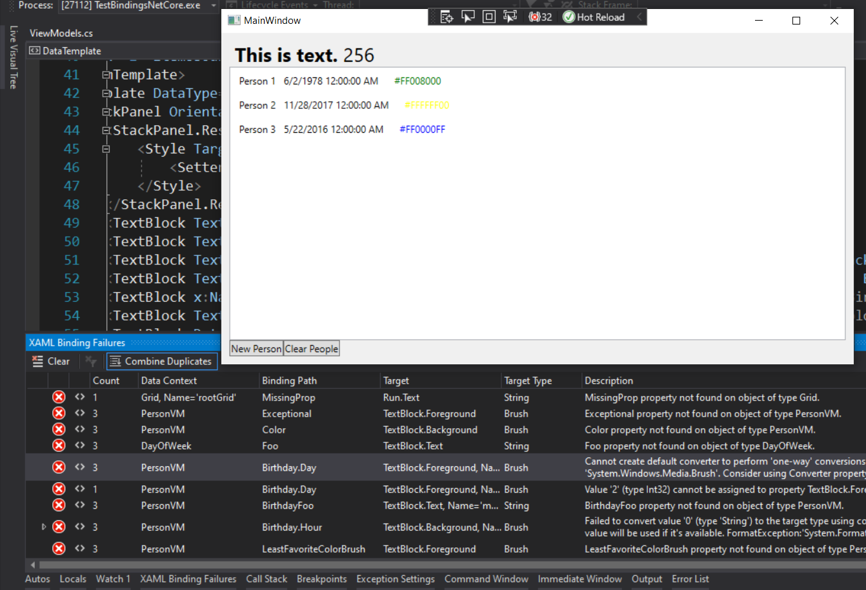
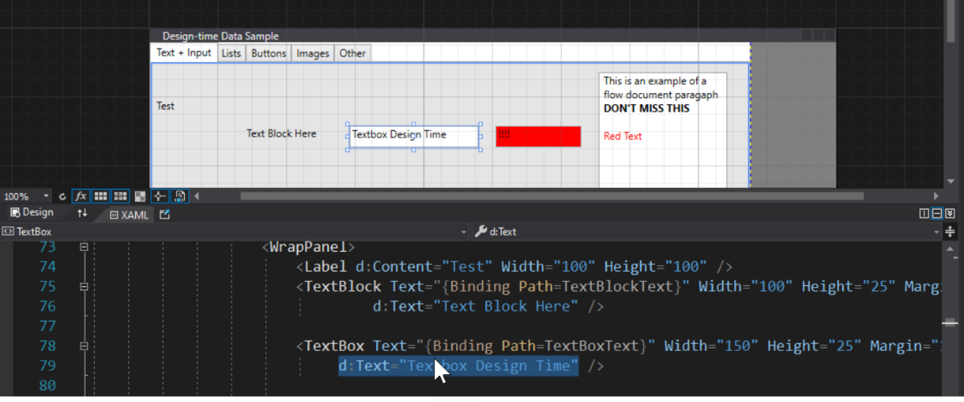
What’s new in WPF?
XAML Hot Reload Improvements
Data Binding Failure Detection & Diagnostics Experience
Simplified Design-time Data using d: (XAML Designer)
IntelliSense Improvements for MVVM scenarios
ClickOnce Deployment & Modern Browser Control (WebView2)
Notes:
For WPF customers we've tackled one of the top customers asks, bringing back ClickOnce for deployment and it's available as you already know for both Windows Forms and WPF developers targeting .NET 5. Similarly WebView2 is also available to bring the modern web control story for WPF developers as well.
In addition customers targeting .NET 5 get many new XAML tooling enhancements, this includes:
Our ever improving XAML Hot Reload feature that makes it possible for you to update your apps UI while the app is running with real data
The new data binding diagnostic experiences that makes sure you don't miss binding failures in your app and are able to navigate right to where the error is located in your XAML
The new and easy to use 'design-time data using d:' for XAML designer, this makes it possible for you to quickly mock almost any property or control without ever having to run your app
And more
So let's jump into a demo of these new XAML features with Dmitry

Slide 10
Windows developer landscape today

Slide 11
The wonderful world of Windows app models
2002: Windows Forms (WinForms)
2006: Windows Presentation Foundation (WPF)
2015: Universal Windows Platform (UWP XAML)
2020: “Project Reunion” (WinUI 3)
Notes:
Over the years we’ve brought you three app models for building Windows desktop apps with .NET. The first, Windows Forms, brings a WYSIWYG design experience for building “Forms over Data” custom business applications quickly. In 2006, with the completely redesigned Windows Vista, we got WPF and a new paradigm for defining application UI with a markup language called “XAML” was born. With UWP XAML, we can build apps for multiple Windows devices, such as Windows 10, Xbox and HoloLens.
<CLICK>
Now we’re working to unify these with “Project Reunion”. Announced Build last year, Project Reunion is a set of libraries, frameworks, components and tools that are common across all Windows 10 versions. For instance, you can take a WinForms app and access Windows 10 APIs, like say battery management, and deploy that app to any build of Windows 10. We’re on the first step on the journey to unify the Windows platform including Windows Forms, WPF and UWP.
We know that all of these app models are important to Windows developers. We also know that .NET developers want to be able to target as many devices as possible, not just Windows, with one codebase, with the great performance, and consistent user experiences that only native development can give you…..
<CLICK>

Slide 12
Going forward
Notes:
Let’s talk about how we’re addressing those needs in .NET 6

Slide 13




.NET Multi-platform App UI
.NET 6
Cross-platform, native UI
Single project system, single codebase
Deploy to multiple devices, mobile & desktop
General availability in .NET 6
.NET Multi-platform App UI
WinUI
Mac Catalyst
iOS
Android
macOS
iOS
github.com/dotnet/maui
Notes:
We’re making progress on .NET Multi-platform App UI that we announced almost a year ago at Build 2020. It will help you deliver performant, beautiful and consistent app experiences across various platforms and devices, and allow you to share code across your mobile and desktop apps. .NET MAUI under the hood uses technologies out there today for building native apps on Windows with WinUI, Mac Catalyst for macOS, and of course, iOS and Android. .NET MAUI abstracts all those frameworks into a single framework built on .NET 6.
<CLICK>
That means it will allow you to build these apps for any device from a single codebase and project system.
<CLICK>
And that includes desktop and mobile across operating systems, Windows, macOS, iOS and Android.
<CLICK>
It will be part of the unified .NET in the .NET 6 timeframe
<CLICK>
and preview 1 dropped last week so you can go check it out!

Slide 14
Blazor hybrid desktop apps
Blazor
Reuse UI components across native and web
Built on top of .NET Multi-platform App UI
Native app container & embedded controls
General availability in .NET 6
Can use native app
container & controls
.NET Multi-platform App UI
macOS
iOS
Notes:
Blazor has become a very popular way to write .NET web apps. We first supported Blazor on the server, then in the browser with WebAssembly, and now we’re extending it again, to enable you to write Blazor desktop apps in .NET 6. This enables you to create hybrid client apps, which combine web and native UI together in a native client application. It is primarily targeted at web developers that want provide rich client and offline experiences for their users.
Blazor hybrid apps is built on top of .NET Multi-platform App UI. It relies on that UI stack for a native application container and native controls (should you want to use them).
Although it will run anywhere .NET MAUI runs, for .NET 6, our primary focus for Blazor hybrid apps on desktop apps.

